Slide 1

Module -6 The Scrum Guide TM
We go through the Guide in Detail – but each element of the Scrum Guide will have to be discussed in further details in subsequent Modules
© MethodScience; Material Designed and Presented by Dr. B. Unhelkar; drawn from The Art of Agile Practice

Slide 2

Agenda – (Based on materials available on Scrum.org)
The Scrum Guide TM
Time Permitting….
The Kanban TM Guide for Scrum Teams TM
(Relased April 2018)
Nexus TM Guide:
The Definitive Guide to scaling Scrum with Nexus: The Rules of the Game (Jan, 2018)
Summary & Consolidation

Slide 3
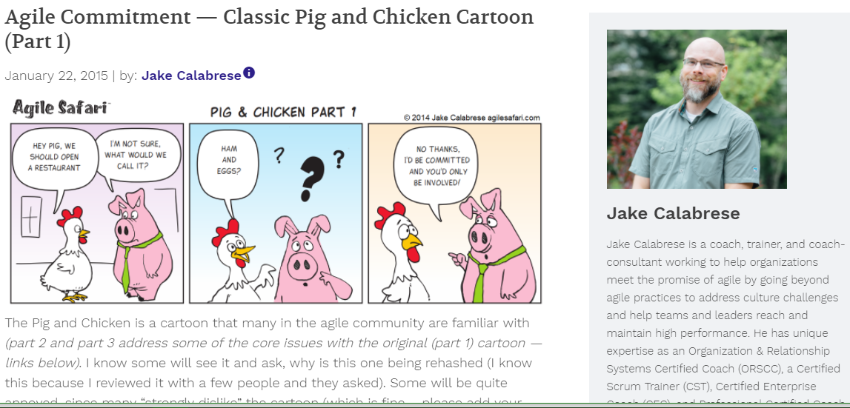
Agile Team - Roles

Slide 4
Key Roles in Agile Scrum (We will use them for Agile Overall – “Pigs” Committed; “Chicken” Involved)
Product Owner
Owns the Product as it gets developed; Hence is in charge of Product backlog
Scrum Master (Agile Coach)
(May be understood as a Team Lead; although not exactly)
Defines sprints/releases (and Iterations – together with the Iteration Manager, in large Projects)
Facilitates, Leads, Fixes and is a Gatekeeper
Has two major Responsibilities
Protecting the team from outside disturbances
Clearing the way by solving problems
Scrum Team
Team members made up of Developers/Testers in Software Projects
Together they Estimate Time and Effort for Backlog items
Recommended Size is = 7 ± 2
Notes:
While these are Scrum roles, they can be used in other non-software development projects as well.

Slide 5
Additional Role - Stakeholders (that support the Agile project)
Stakeholders
Project Sponsor – who is paying for the Project
Customer – if it is an External project
Vendor – who is providing input in the project or has a stake in the project
Senior Managers / Executive – who also have an interest in the project
End User representative
Stakeholders have a say in the Product Backlog

Slide 6

Agile Artifacts
User Stories
Basic Functional Requirement
Product Backlog
Total list of product features
Wish list
Sprint Backlogs
Subset of product backlog items
Work remaining on each task is tracked
Burn down Charts
Depicts the DONE and outstanding Stories (functionality) in the Project

Slide 7
Sub-Module Kaizen & the Kanban Board
Continuous Improvement – visible to all on the Wall
© MethodScience; Material Designed and Presented by Dr. B. Unhelkar; drawn from The Art of Agile Practice

Slide 8
What is Kaizen?
Kaizen can be considered as a business strategy that is based around continuous improvement in areas of work within an organization that contribute to the goals and results of the organization.
Kaizen includes aspects of technology, leadership, quality, costs, productivity, employee satisfaction, security, and company culture.
Kaizen is an approach that includes all staﬀ in the organization to participate in the process of continuous and ongoing improvement.
There are ﬁve founding elements in Kaizen that are shown in the middle of Figure 2.7.

Slide 9
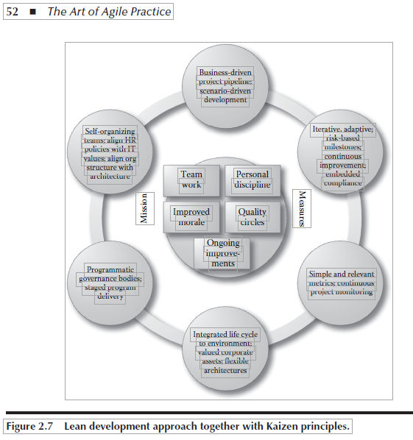
Kaizen Elements
Team Work
Personal Discipline
Improved Morale
Quality Circles
Ongoing Improvement

Slide 10
Kaizen encompasses a cycle of activities to achieve continuous improvement
Standardize a process to achieve a goal.
Measure the standardized process through its multiple elements.
Test the measurements of the process in the context of its requirements or goals.
Innovate to achieve requirements and raise productivity.
Standardize the new and improved processes.

Slide 11
Kanban Board
Kanban in Japanese means "visual signal" or "card.“
Kanban forms the philosophical basis for the “Wall” of Agile
Kanban enables easy, current and visual communication of an initiative (Project)
Toyota used these technique in JIT (Just in Time) inventory to reduce waste and maximize value.

Slide 12
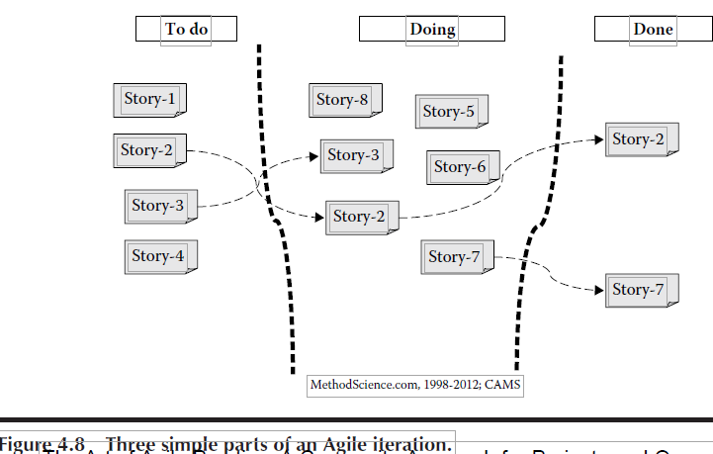
Figure 4.8: An Agile “Wall”

Slide 13
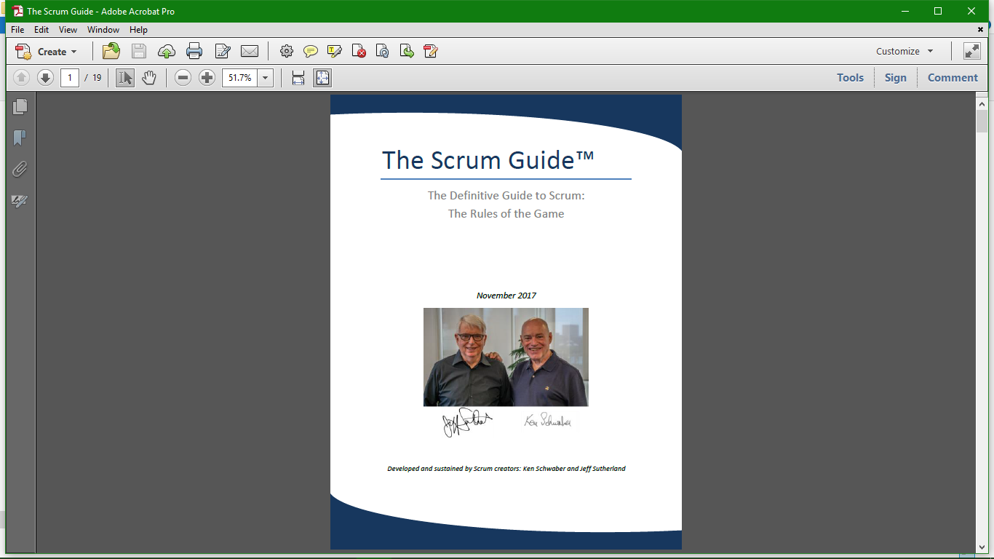
Go to the Scrum Guide…

Slide 14
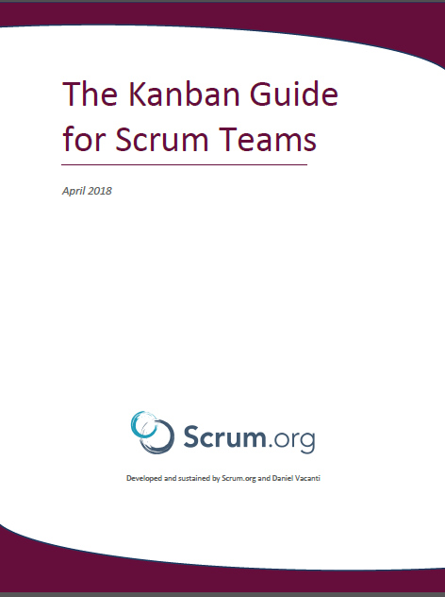

Slide 15
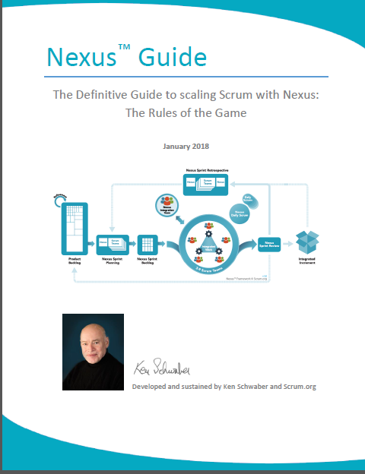

Slide 16


Slide 17
Conclusions & Future Directions
We discussed…??
Do you see what we see?

Slide 18
Sub-Module Agile Teams
Cross-Functional; Co-Located;
© MethodScience; Material drawn from The Art of Agile Practice (B. Unhelkar)

